Slide 1
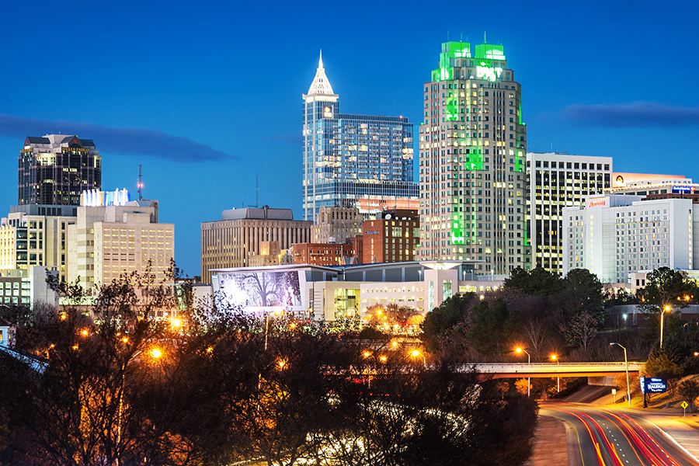


TriangleRelo Team Project Review
Developers:
Steve Hulme, Joshua Gomez, Logan Sawyer, Michael Ashe, and Derek Johnson
March 2018

Slide 2
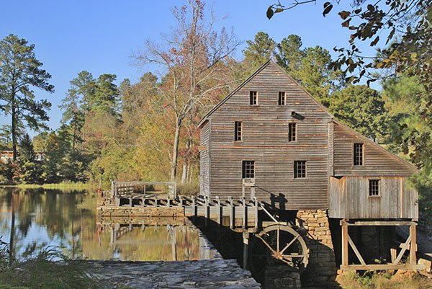
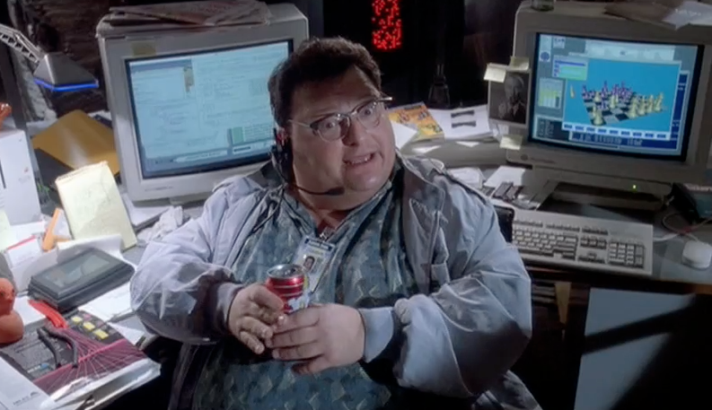
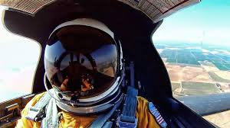
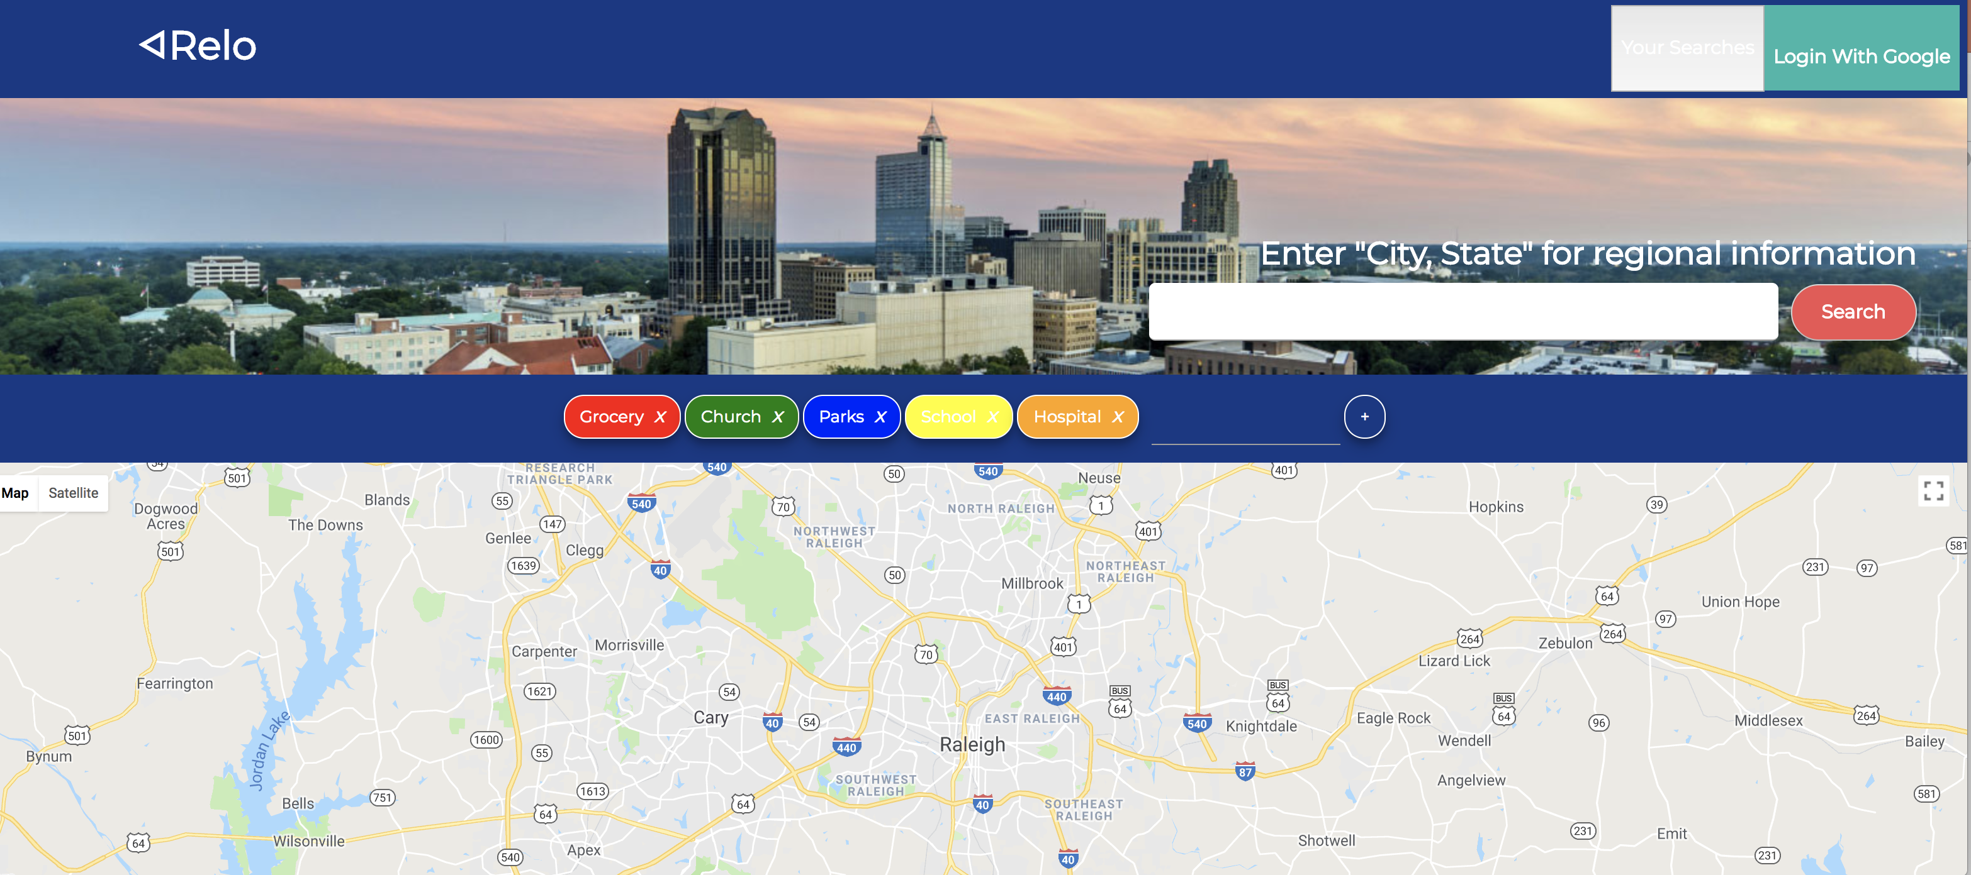


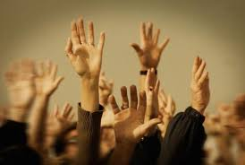
Agenda
Introduction of team
High Level Overview
Demonstration
Team Development Stories
Planned Improvements
Questions and Answers

Slide 3

TriangleRelo High Level Overview

Slide 4
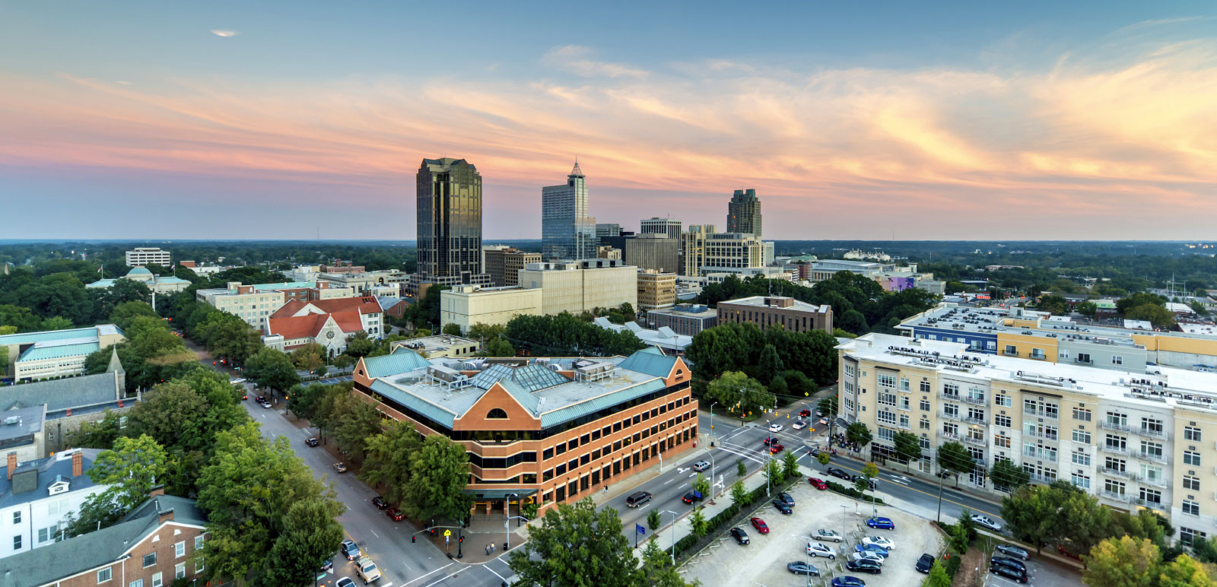
Demo

Slide 5

Team Development Stories
Steve
Idea, SCRUM Master , MongoDB, Heroku
Joshua
React, UI, APIs, Chips
Logan
React, UI, APIs, Chips
React, UI, GoogleOAuth
Michael
Derek
MongoDB, Presentation

Slide 6

Planned Improvements
Deliverables | Description
Authentication | Add more login options and save more personal info
Saved Searches | See all searches and sharing
Mapping | Functionality outside of local area

Slide 7
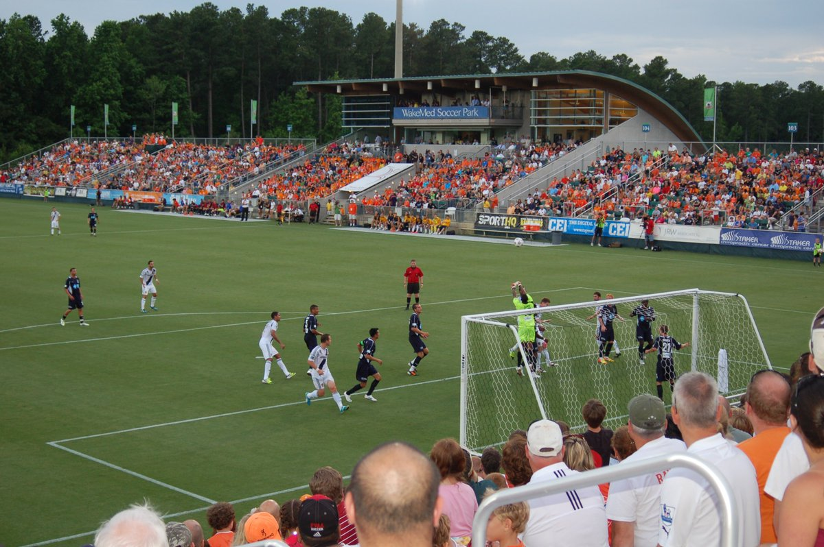
Questions and Answers

Slide 8
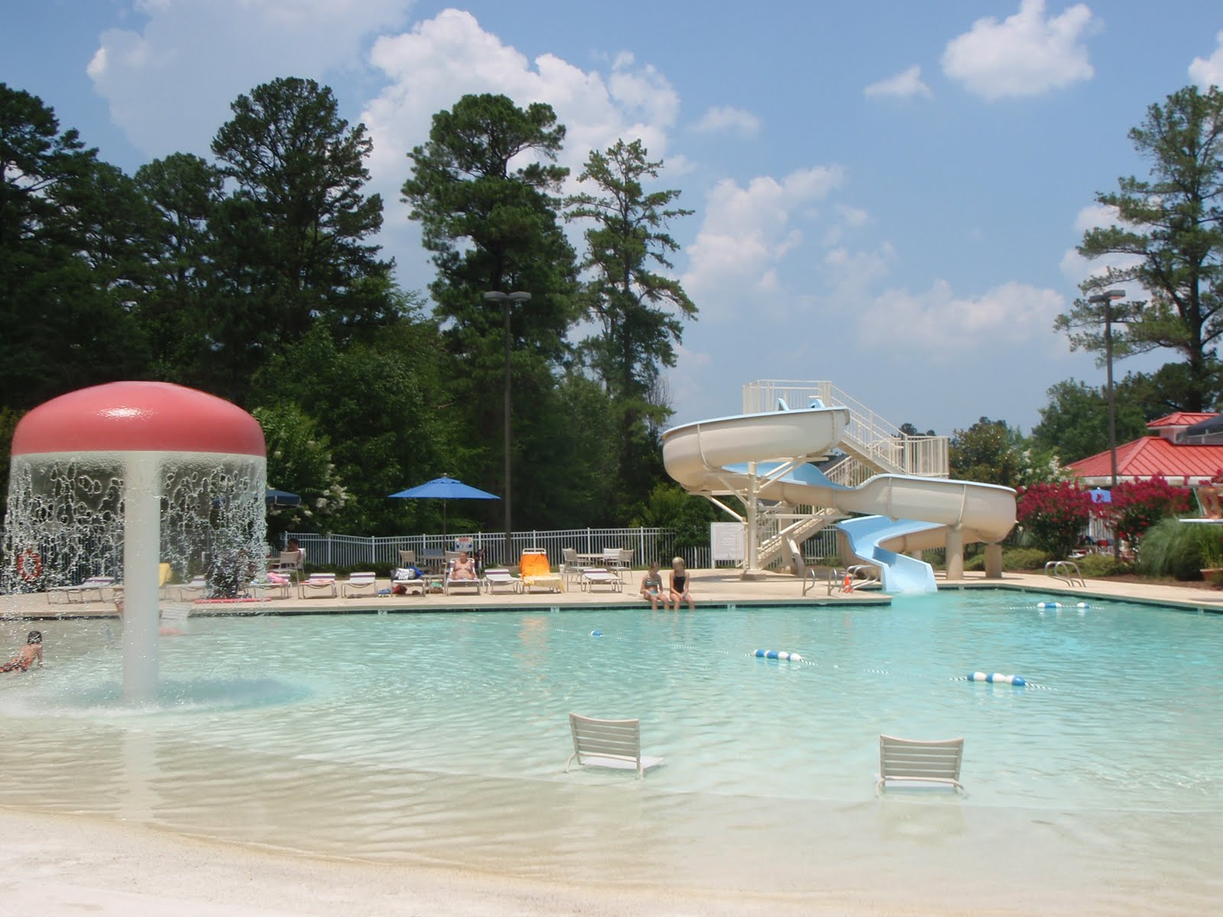
Thank you!

